Slide 1

SKY RANCH MIDDLE SCHOOL
HOME OF THE THUNDERBOLTS
To Most People the sky is the limit--To Thunderbolts, the sky is Home!!

Slide 2

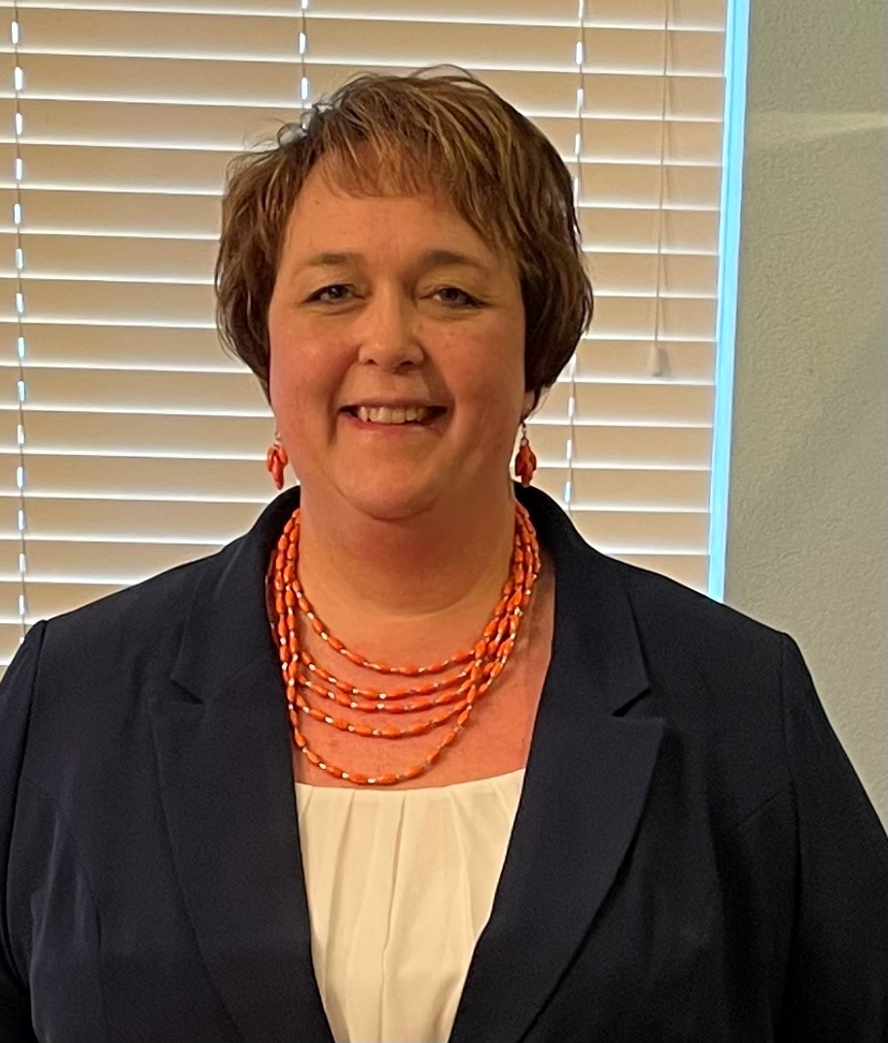
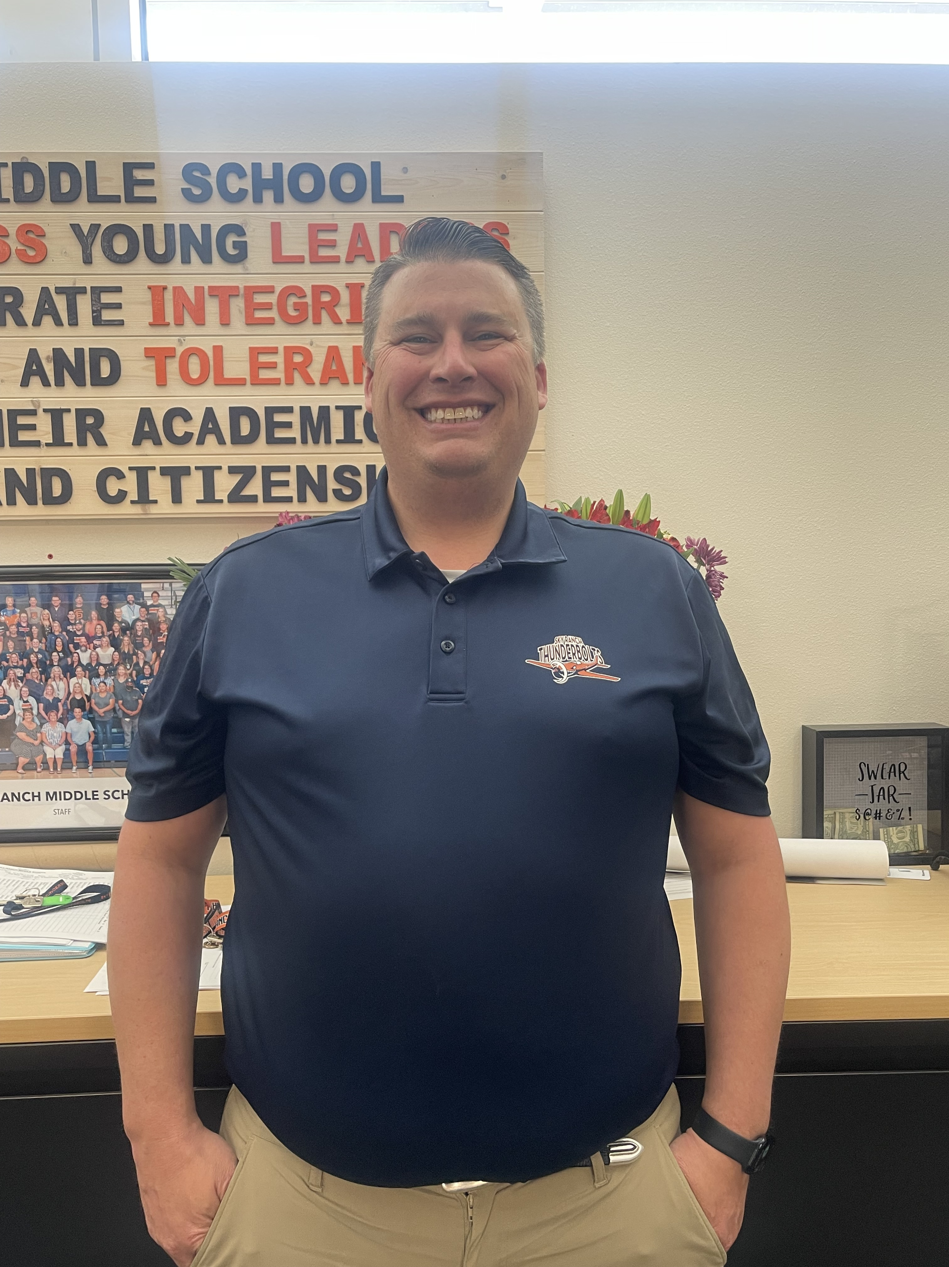
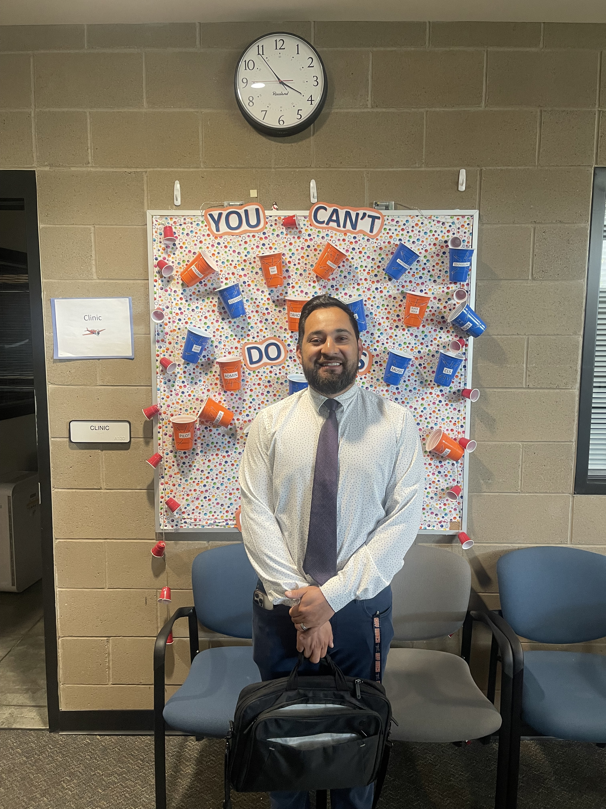
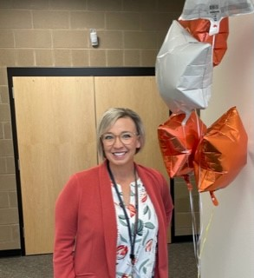
THUNDERBOLTS
BRAD NAUGHTON
Asst. Principal
KATI FITZPATRICK
Asst. Principal
HUGO GUILLEN
Dean
JILL BAYLISS
Principal

Slide 3
THUNDERBOLTS
NAVY BLUE
ORANGE

Slide 4
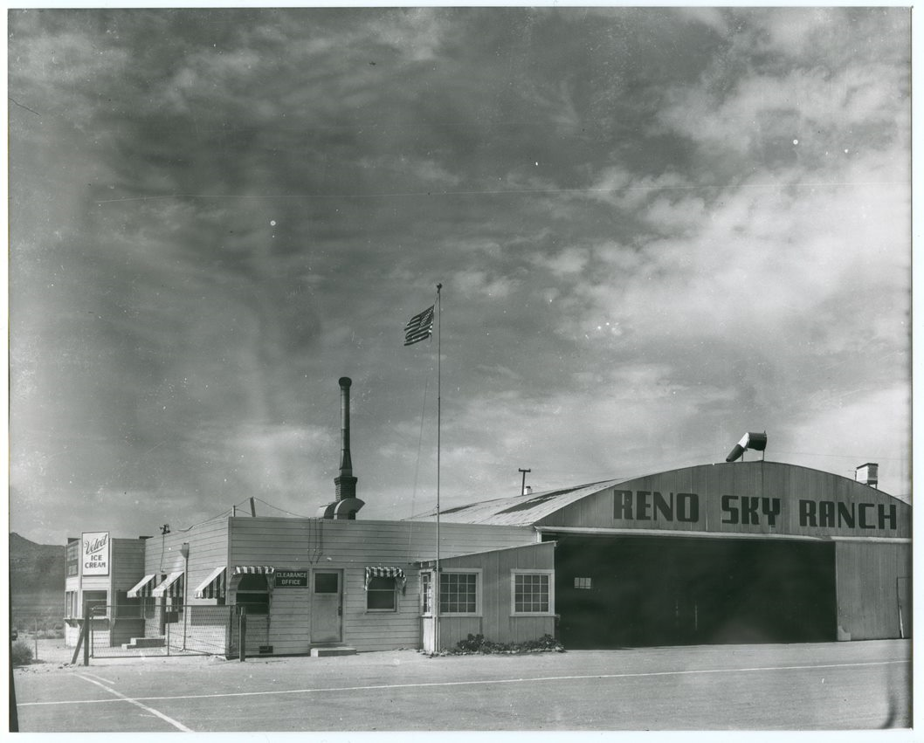
Original Sky Ranch Airport
Opened in November 1941
Closed 1970ish
Original site for RENO AIR RACES 1964 and 1965

Slide 5
New Building –opened Aug. 2019

Slide 6

OUR FLIGHT PLAN What we want our students to do!!
Sky Ranch Middle School builds Fearless young Leaders who demonstrate Integrity, Grit, Honesty, and Tolerance through their academic excellence and citizenship.
 | F FEARLESS: When fears are grounded, dreams take flight. | L LEADER: Know the way, go the way, show the way. | I INTEGRITY: Do the right thing even when no one is watching. | G GRIT: Perseverance and passion to keep you going. | H HONESTY: If you want to be trusted, be honest. | T TOLERANCE: A willingness to embrace another’s uniqueness.

Slide 7
SRMS GRADING POLICY
Philosophy of Grading
Grading should represent mastery of standards-based content.
Grading represents what a student is able to do!
HOW GRADING WORKS:
Grades are based on two categories—Classwork/Homework and Assessments/Projects
Classwork/Homework is 25%
Assessment/Projects is 75%
Multiple opportunities to succeed—retakes!!

Slide 8
STUDENT SCHEDULES
6TH GRADE
6 period day
4 person Teams—
  Math
  Science
  Social Studies
  English
2 period Electives
  One period-- MUSIC
  Other period– 2 electives each a Semester long
Example Schedule
1st Period – Math
2nd Period –SS
3rd Period –Music
4thPeriod Elective/Elective
Enrichment
5th Period – ELA
6th Period – Science
ELECTIVES –6th Grade
PE
ART
STEM
21st Century Media
Creative Writing
Coding
Engineering and Design
MUSIC
  Band
  Choir
  Orchestra
  Music Exploration

Slide 9
REGISTRATION
Please complete ON-LINE registration
Registration for Electives
  Electronic form for 6th—7th—or 8th. One submission!! Due June 1st!!
Registration Days—at Building in Aug.
Website: www.washoeschools.net/skyranch

Slide 10


6th Grade Registration FORM
QR Code for Elective FORM
Use the links on the website to access the handouts and course descriptions.

